Slide 1

Face
Recognition Attendance System
for School Events
A Capstone Project presented to the
COLLEGE OF ENGINEERING
Jose Rizal Memorial State University
City of Dapitan in Partial Fulfillment of the Requirements
In
Software Design
Bachelor of Science in Computer Engineering II
2nd Semester S.Y. 2024-2025

Slide 2
VALID8
Team:
ALBAIRA, BORJA, CADALIN, CAMOC
JOSE RIZAL MEMORIAL STATE UNIVERSITY

Slide 3
Team Workflow Documentation
📌 Sprint 1: Project Planning & Setup
Project Manager (Iryl) ✅ Set up Trello & assign tasks ✅ Set up GitHub repository & version control
Backend Developers (Joy) ✅ Install Java & set up Spring Boot environment ✅ Set up PostgreSQL/MySQL database ✅ Initialize Spring Boot REST API (basic structure)
Frontend Developer (Laizah) ✅ Set up HTML, CSS, JavaScript project ✅ Install Face API.js for live face scanning
AppSheet Developer (Iryl) ✅ Create AppSheet project ✅ Connect AppSheet to Java backend via REST API
JJJOSE RIZAL MEMORIAL STATE UNIVERSITY

Slide 4
Team Workflow Documentation
📌 Sprint 2: User Authentication & Role Management
Backend Developers ✅ Implement user authentication API (Spring Security for login, roles) ✅ Connect authentication to PostgreSQL
Frontend Developer ✅ Create login & registration UI ✅ Implement AJAX (Fetch API) for authentication requests
AppSheet Developer ✅ Set up user authentication in AppSheet ✅ Ensure AppSheet can authenticate via backend API
Testing & Documentation ✅ Test authentication (Website & AppSheet) (Tester) ✅ Document authentication system (Documentation)
JJJOSE RIZAL MEMORIAL STATE UNIVERSITY

Slide 5
Team Workflow Documentation
📌 Sprint 3: Event Management & Attendance Tracking
Backend Developers ✅ Develop Event Management API (create, edit, delete events) ✅ Implement Attendance Tracking API
Frontend Developer ✅ Build event management pages (create, update, delete) ✅ Implement AJAX requests for event creation
AppSheet Developer ✅ Create event management interface in AppSheet ✅ Ensure attendance tracking syncs with backend
Testing & Documentation ✅ Test event creation & attendance tracking (Website & AppSheet) (Tester) ✅ Document event system ( Documentation)
JJJOSE RIZAL MEMORIAL STATE UNIVERSITY

Slide 6
Team Workflow Documentation
📌 Sprint 4: Face Recognition & AppSheet Integration
Backend Developers ( ✅ Implement face recognition API (AWS Rekognition or OpenCV) ✅ Develop API endpoint for AppSheet to send images & verify attendance
Frontend Developer ✅ Integrate Face API.js for browser-based face scanning
AppSheet Developer ✅ Add photo capture feature in AppSheet ✅ Connect AppSheet to the face recognition API
Testing & Documentation ✅ Test face recognition accuracy Tester) ✅ Document face recognition process & AppSheet integration (Documentation)
JJJOSE RIZAL MEMORIAL STATE UNIVERSITY

Slide 7
Team Workflow Documentation
📌 Sprint 5: Admin Dashboard & Reports
Backend Developers ✅ Develop Attendance Reports API ✅ Optimize database queries for reports
Frontend Developer ✅ Build admin dashboard UI
AppSheet Developer ✅ Display attendance reports in AppSheet ✅ Ensure attendance records from Website & AppSheet sync correctly
Testing & Documentation ✅ Verify report accuracy (Tester) ✅ Finalize system documentation (Documentation)
JJJOSE RIZAL MEMORIAL STATE UNIVERSITY

Slide 8
Team Workflow Documentation
📌 Sprint 6: Deployment & Final Testing
🔹 Backend Developers ✅ Deploy Spring Boot backend to AWS (or another server) ✅ Set up database deployment (PostgreSQL/MySQL)
🔹 Frontend Developer ✅ Deploy HTML/CSS/JavaScript website
🔹 AppSheet Developer ✅ Finalize AppSheet setup & API connectivity
🔹 Testing & Documentation ✅ Conduct full system testing (Tester) ✅ Document deployment process (Documentation)
JJJOSE RIZAL MEMORIAL STATE UNIVERSITY

Slide 9
Trello
JOSE RIZAL MEMORIAL STATE UNIVERSITY

Slide 10
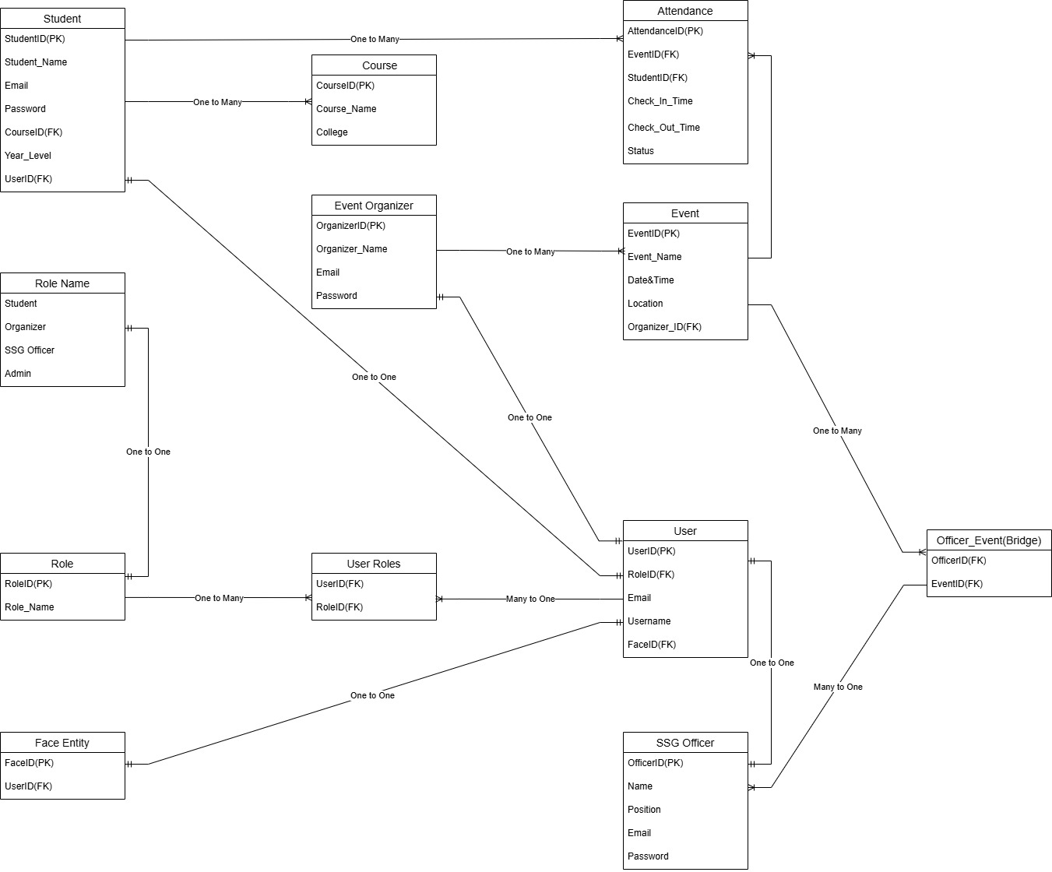
Entity Relationship Diagram
JOSE RIZAL MEMORIAL STATE UNIVERSITY

Slide 11
Functional Requirements
User Management: Admins can create, edit, and delete user accounts. Role-based access control for students, SSG officers, event organizers, and admins.
Event Management: Event organizers can create, edit, and delete events.
Attendance Tracking: SSG Officer verifies student attendance via Face recognition.
Attendance Reports: Admins can generate event attendance reports. Students can view their attendance history.
Security & Authentication: User login using credentials or Google/Facebook login. Secure API for communication between the website and backend.

Slide 12
Non-Functional Requirements
Performance: Must handle at least 200+ concurrent users without crashing. Attendance verification should take less than 5 seconds per student.
Usability: UI should be user-friendly for both students and SSG officers. Mobile-responsive design for better accessibility.
Security: Encrypted user data and secure authentication methods. Role-based access ensures only authorized users can perform specific actions.
Scalability: Backend should support future feature additions, like attendance analytics.
Reliability: The system should maintain 99% uptime during school events.

Slide 13
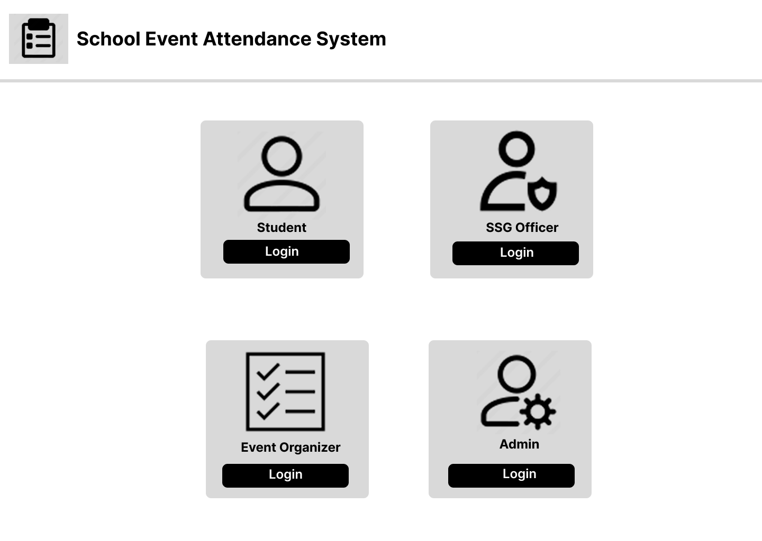
Wireframes
JOSE RIZAL MEMORIAL STATE UNIVERSITY

Slide 14
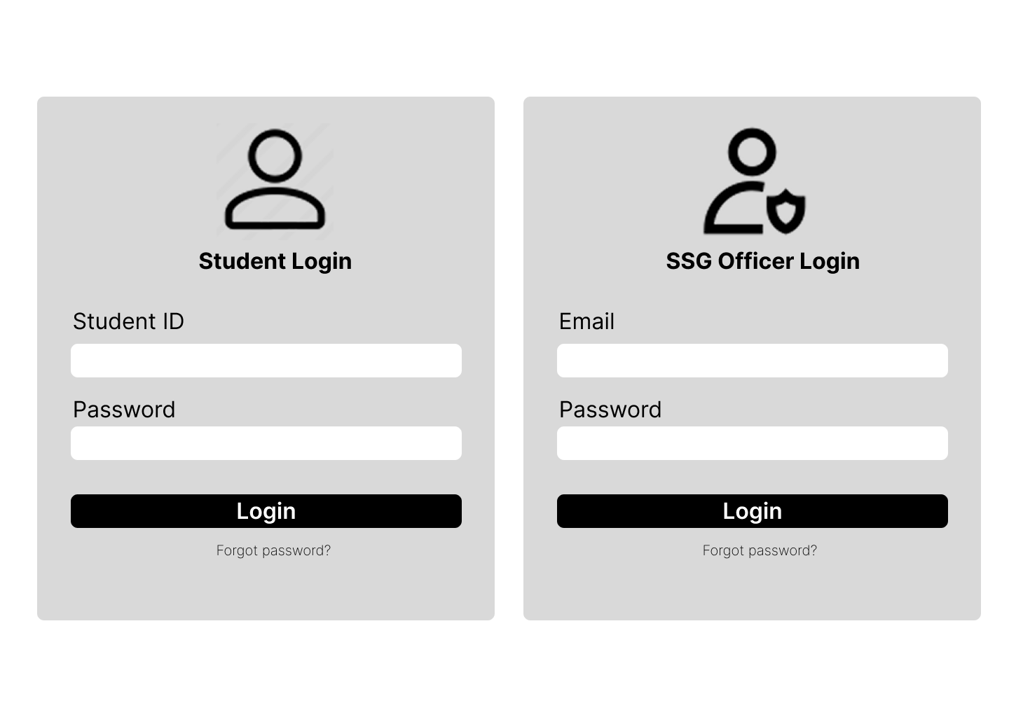

Slide 15
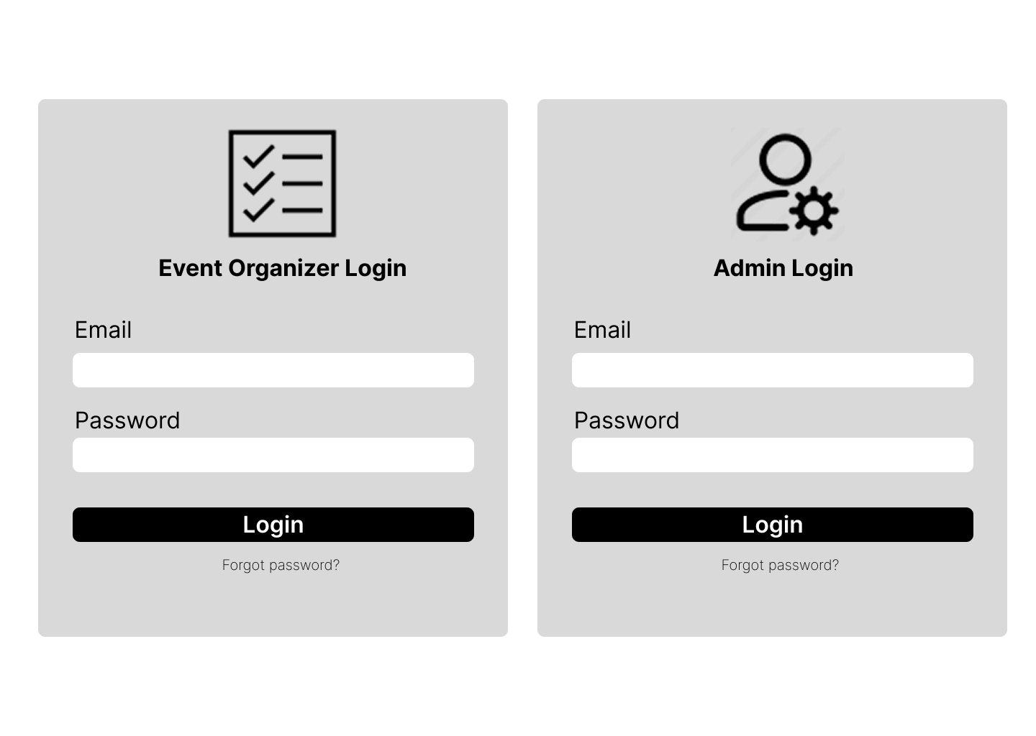

Slide 16
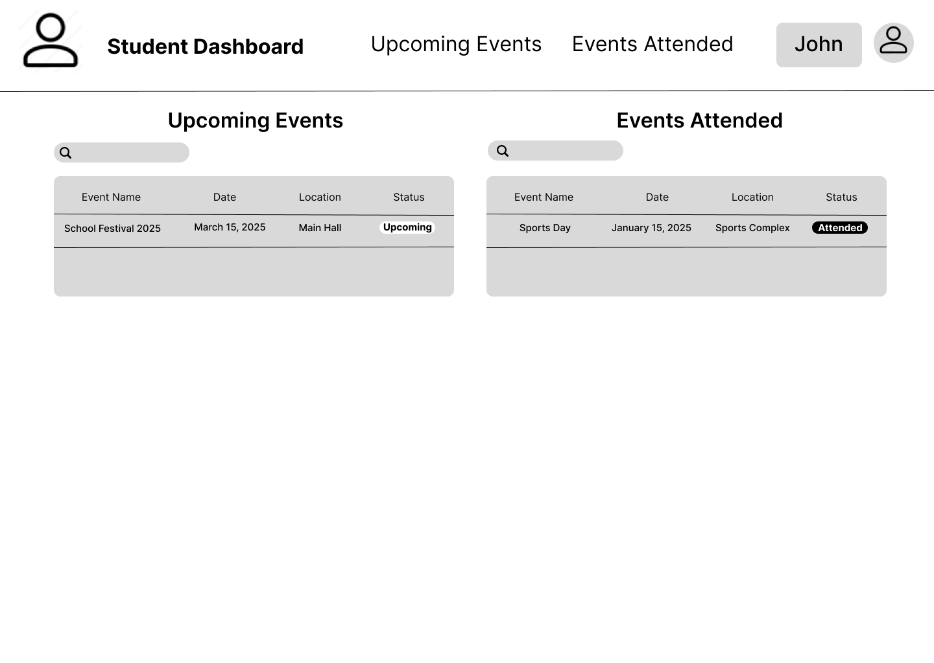

Slide 17
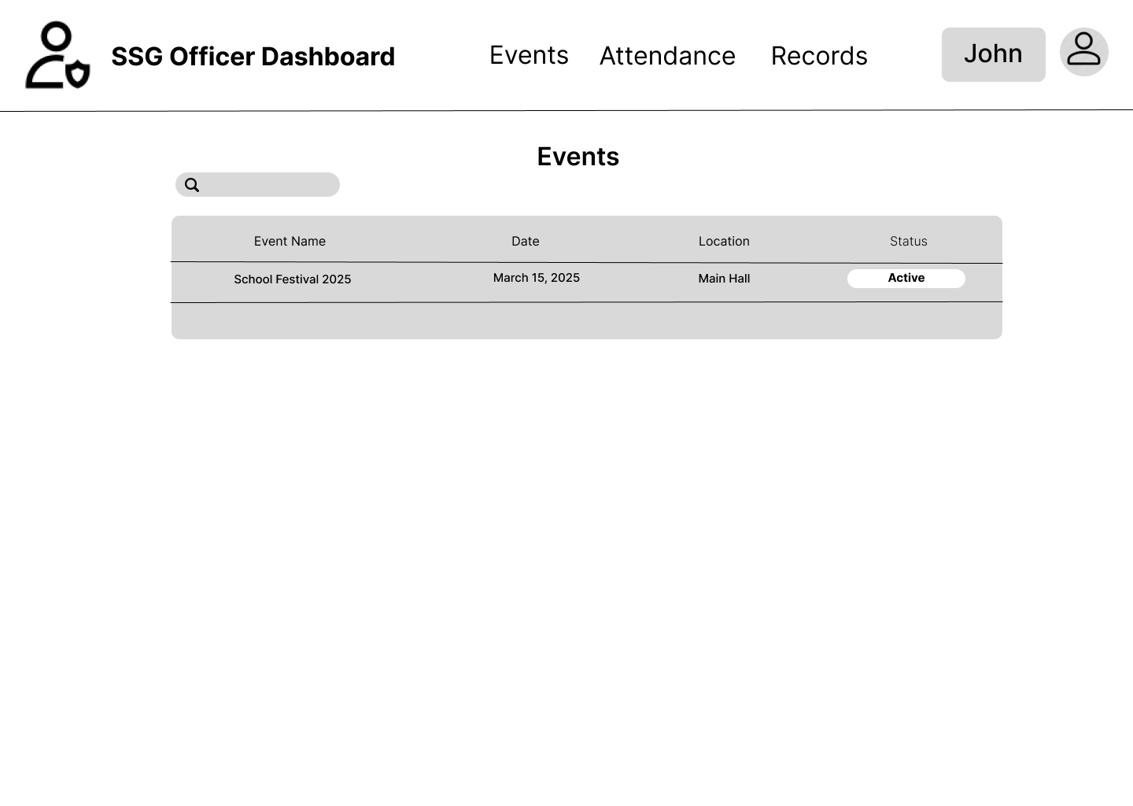

Slide 18
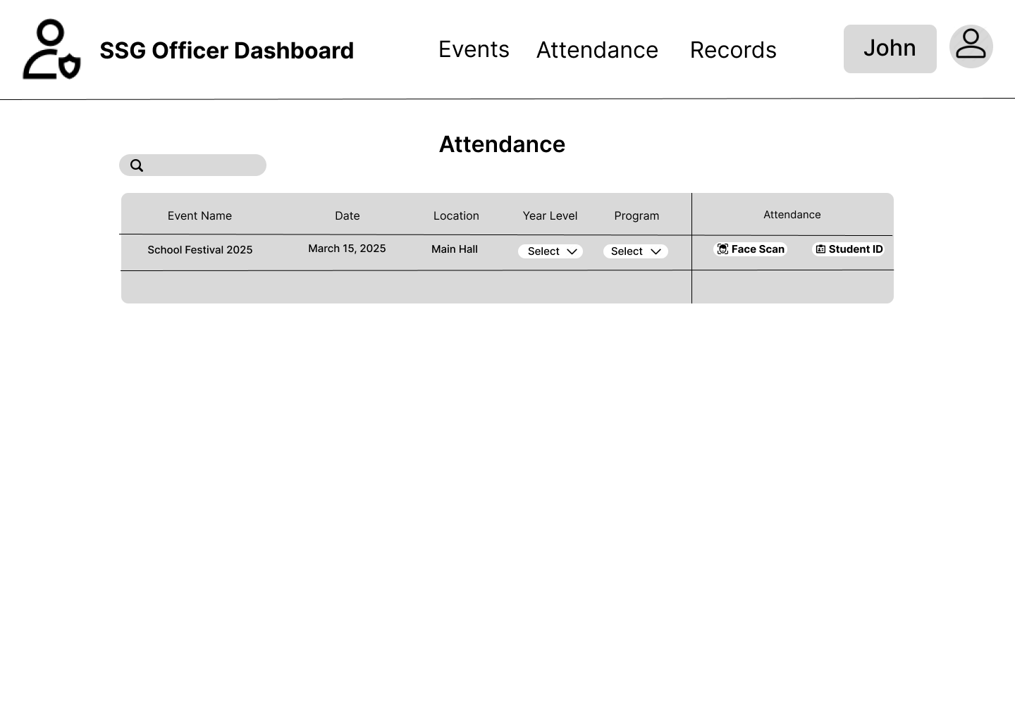

Slide 19
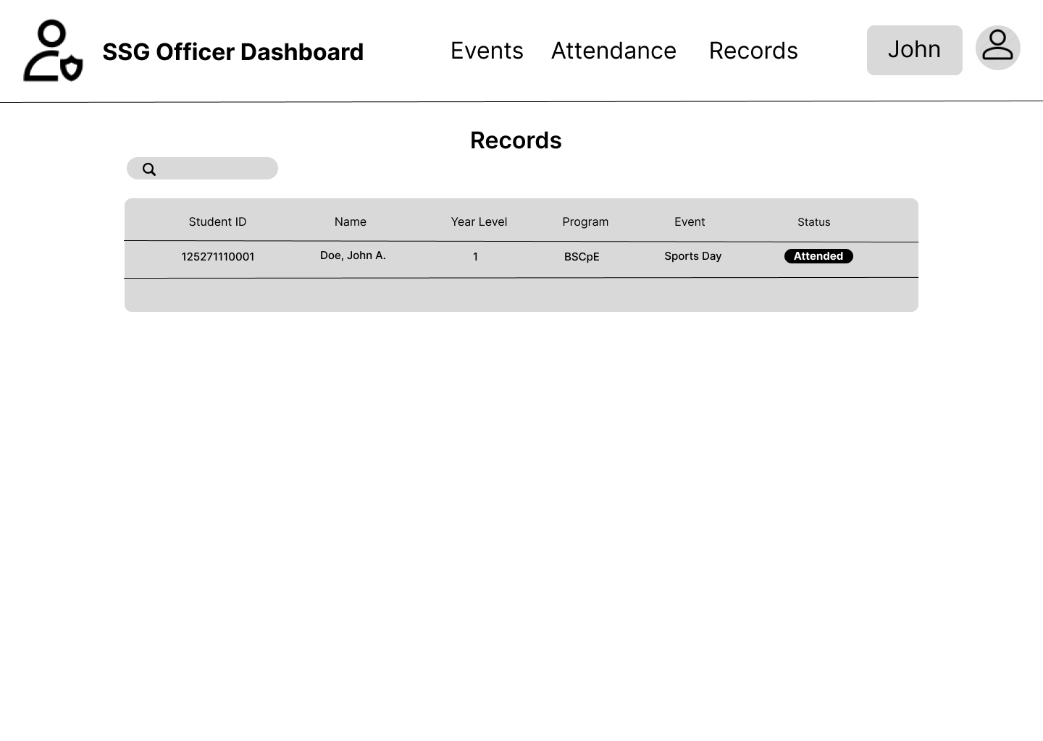

Slide 20
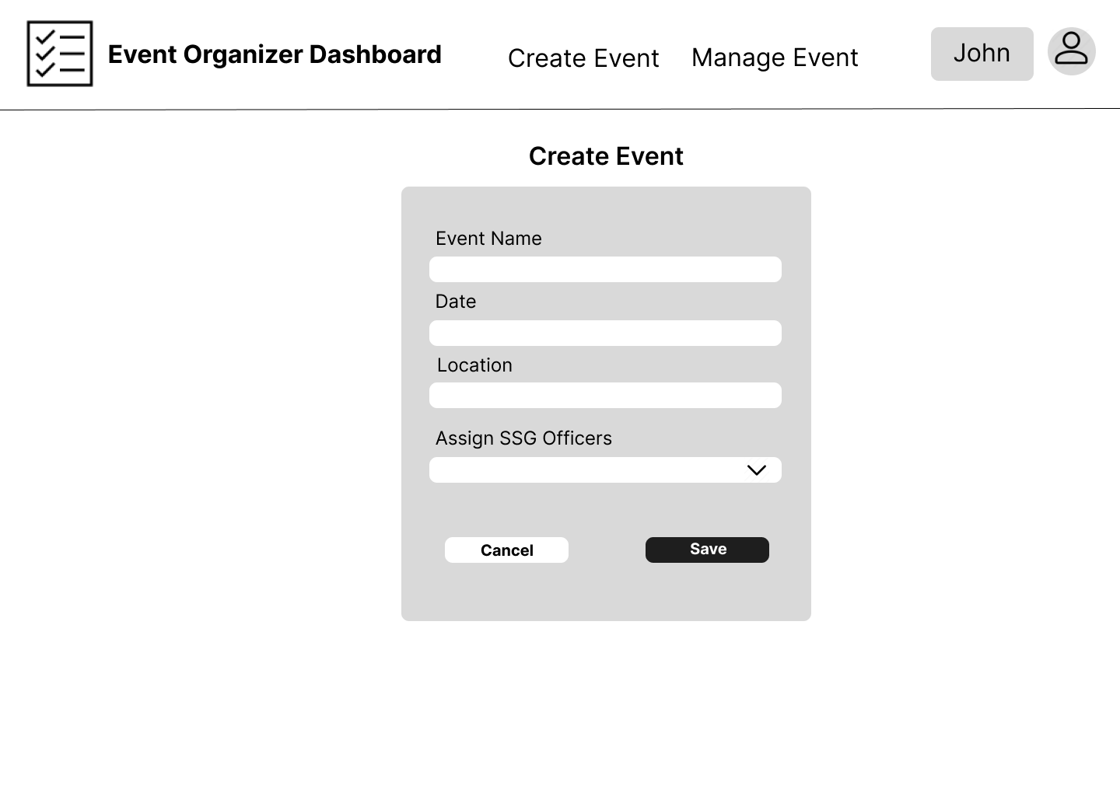

Slide 21
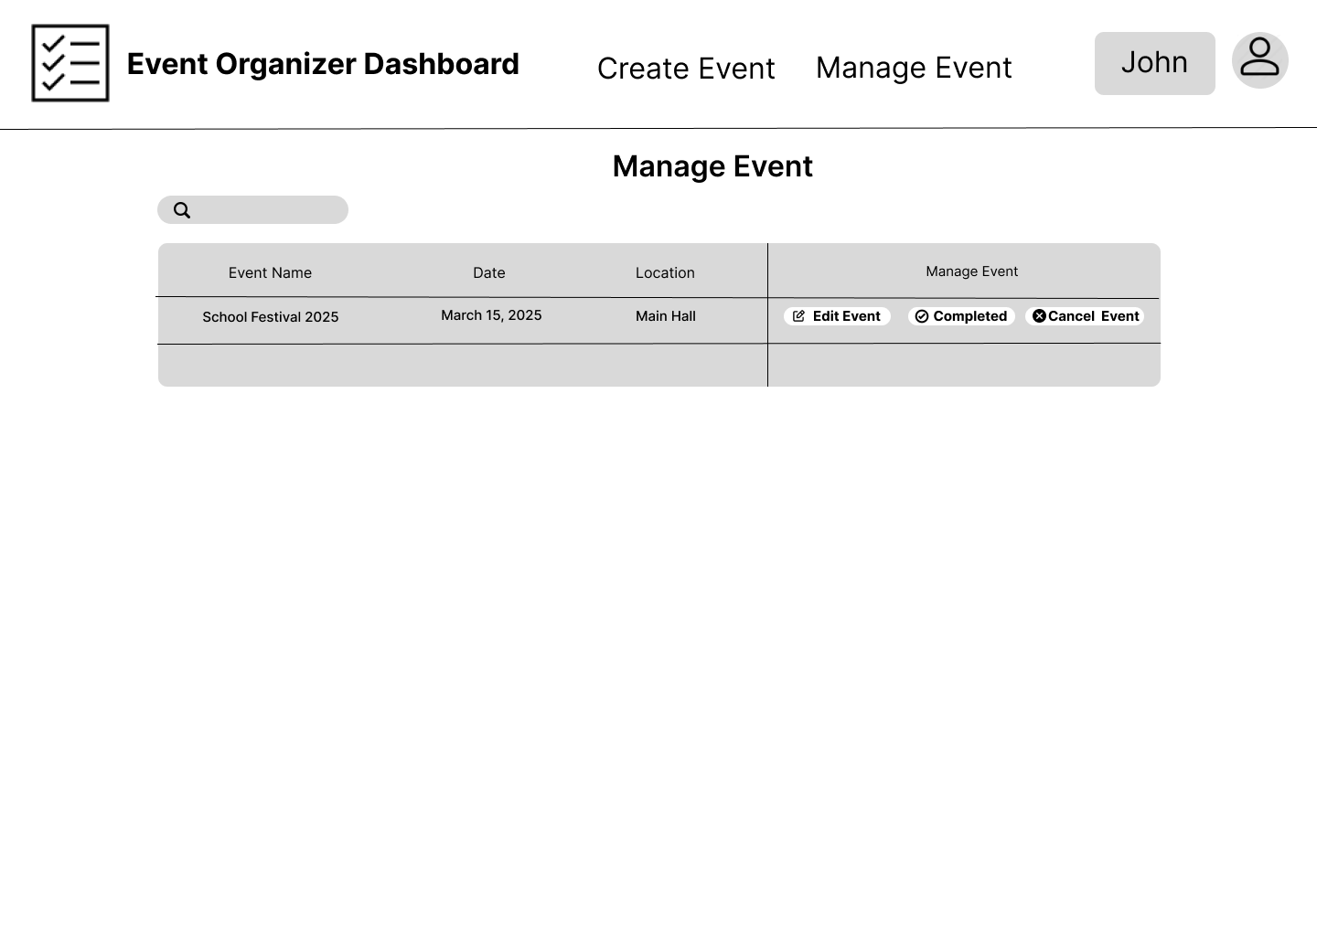

Slide 22
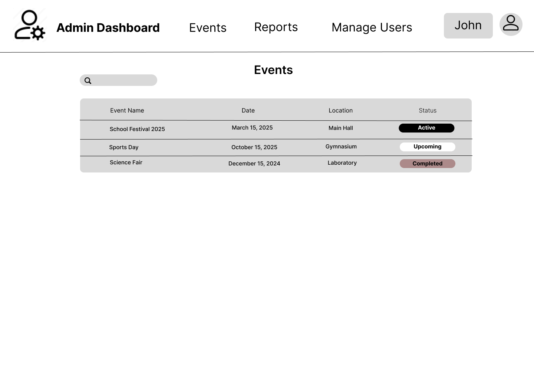

Slide 23
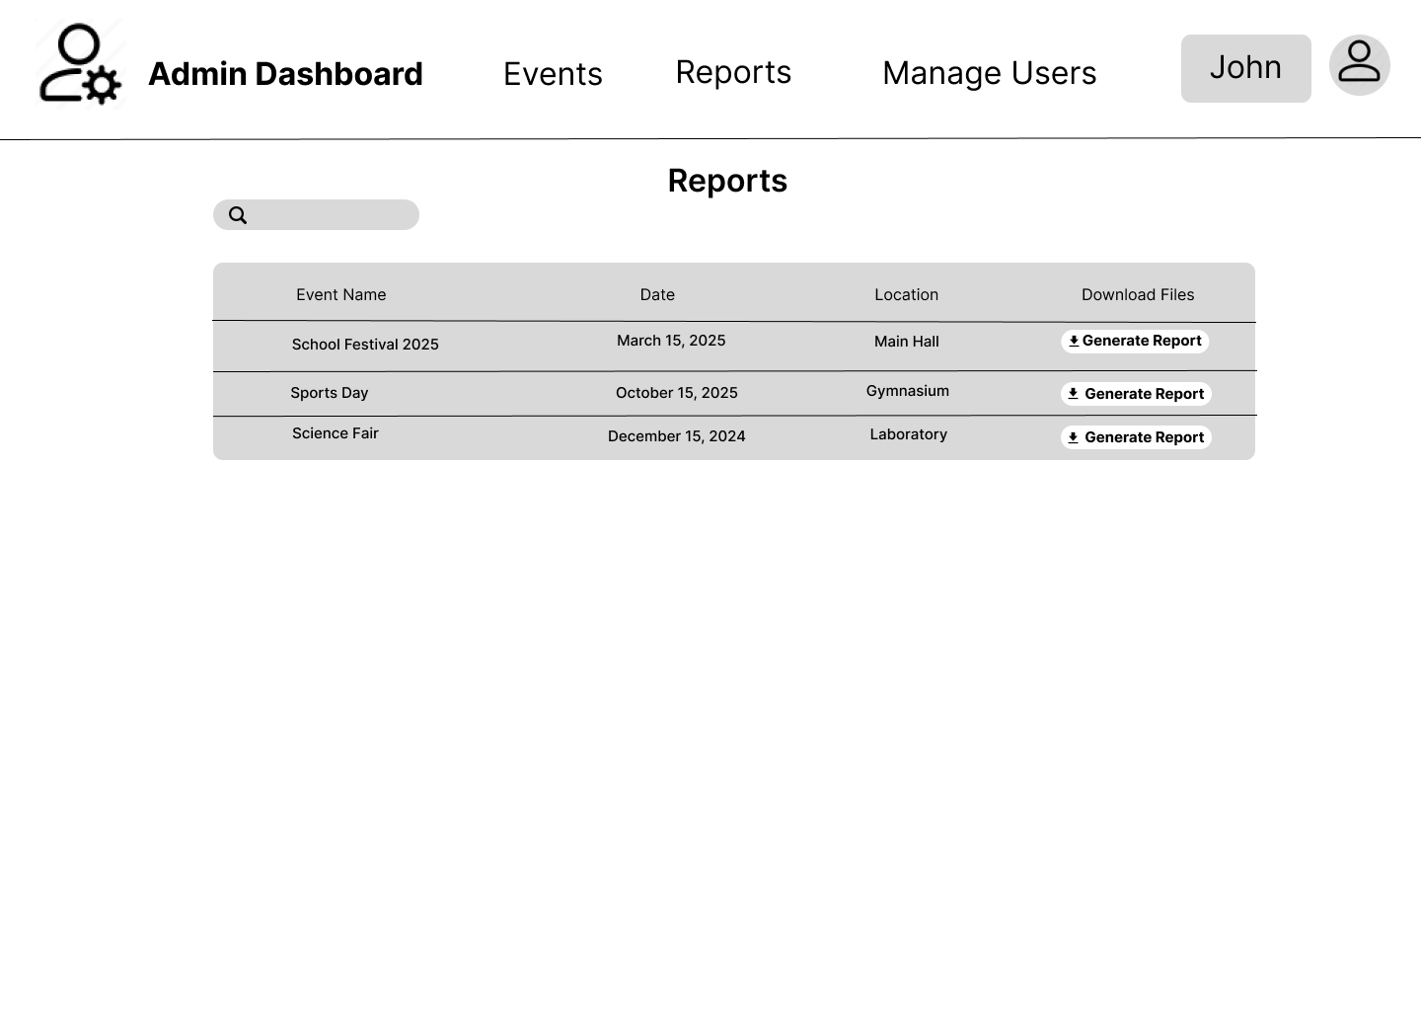

Slide 24
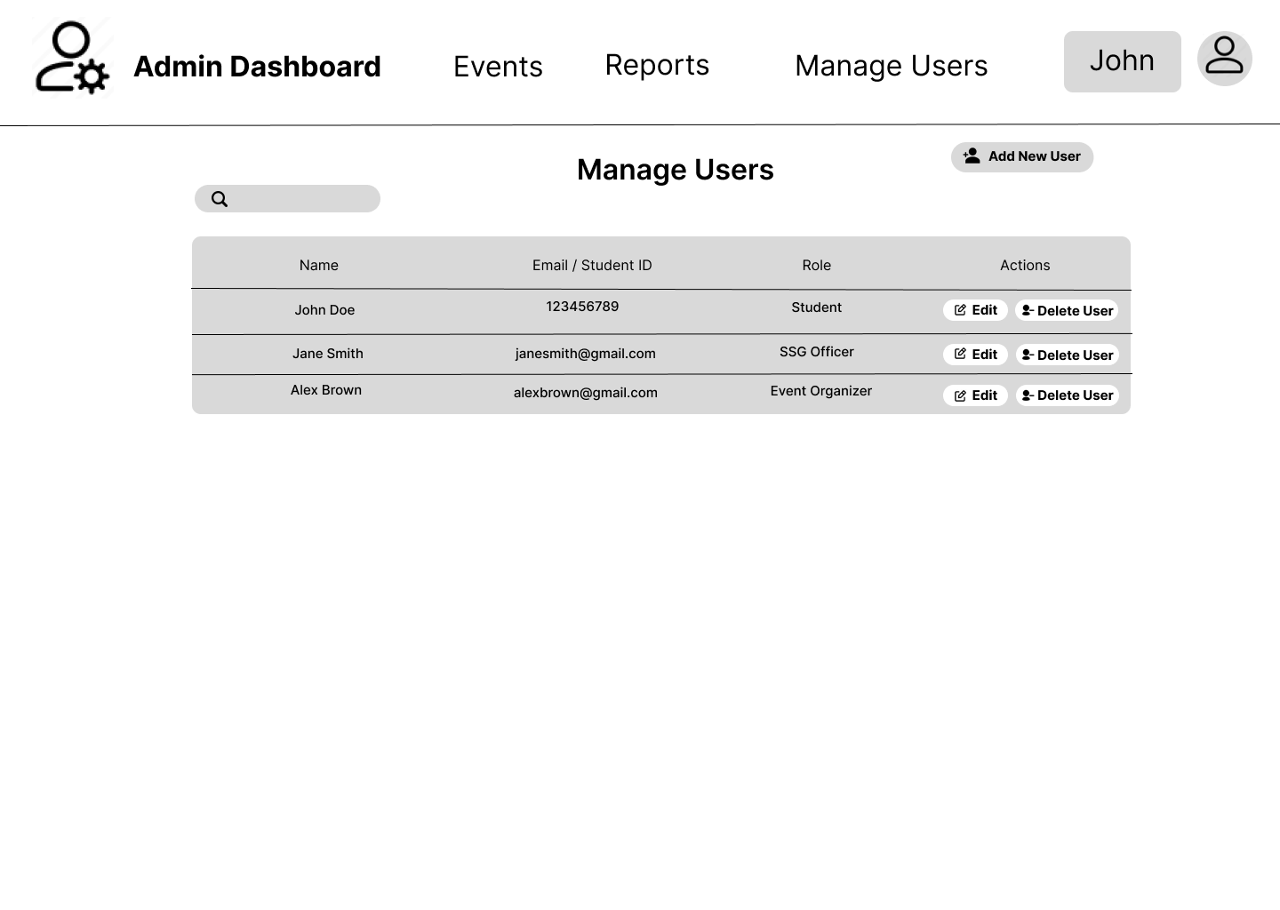

Slide 25
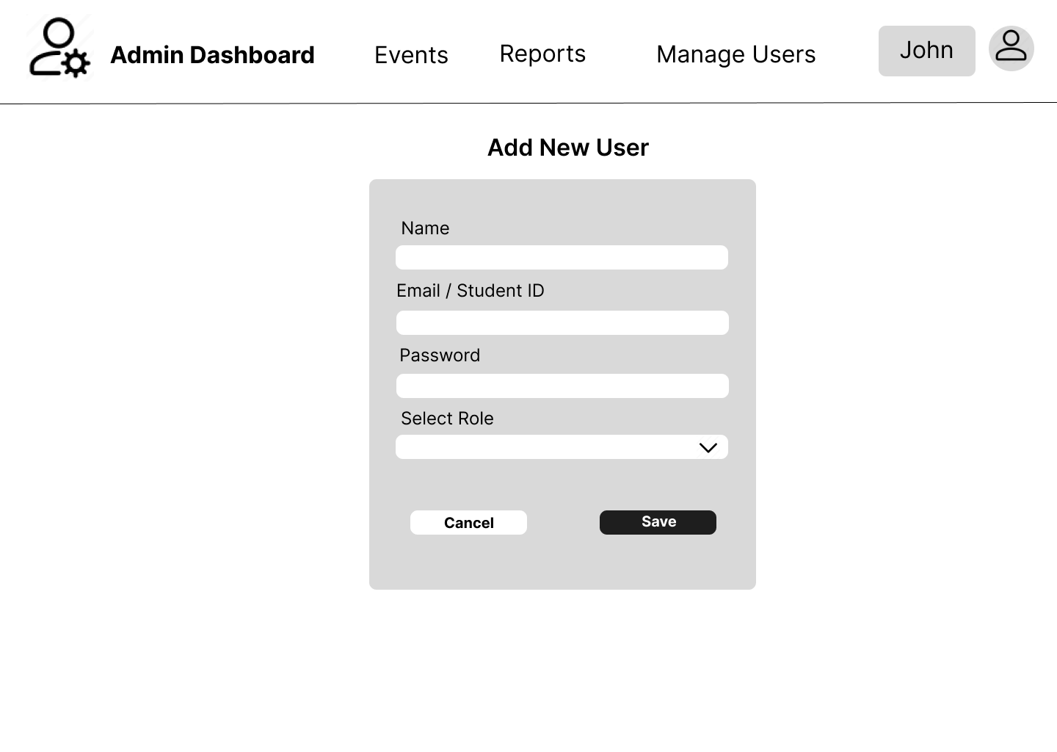

Slide 26
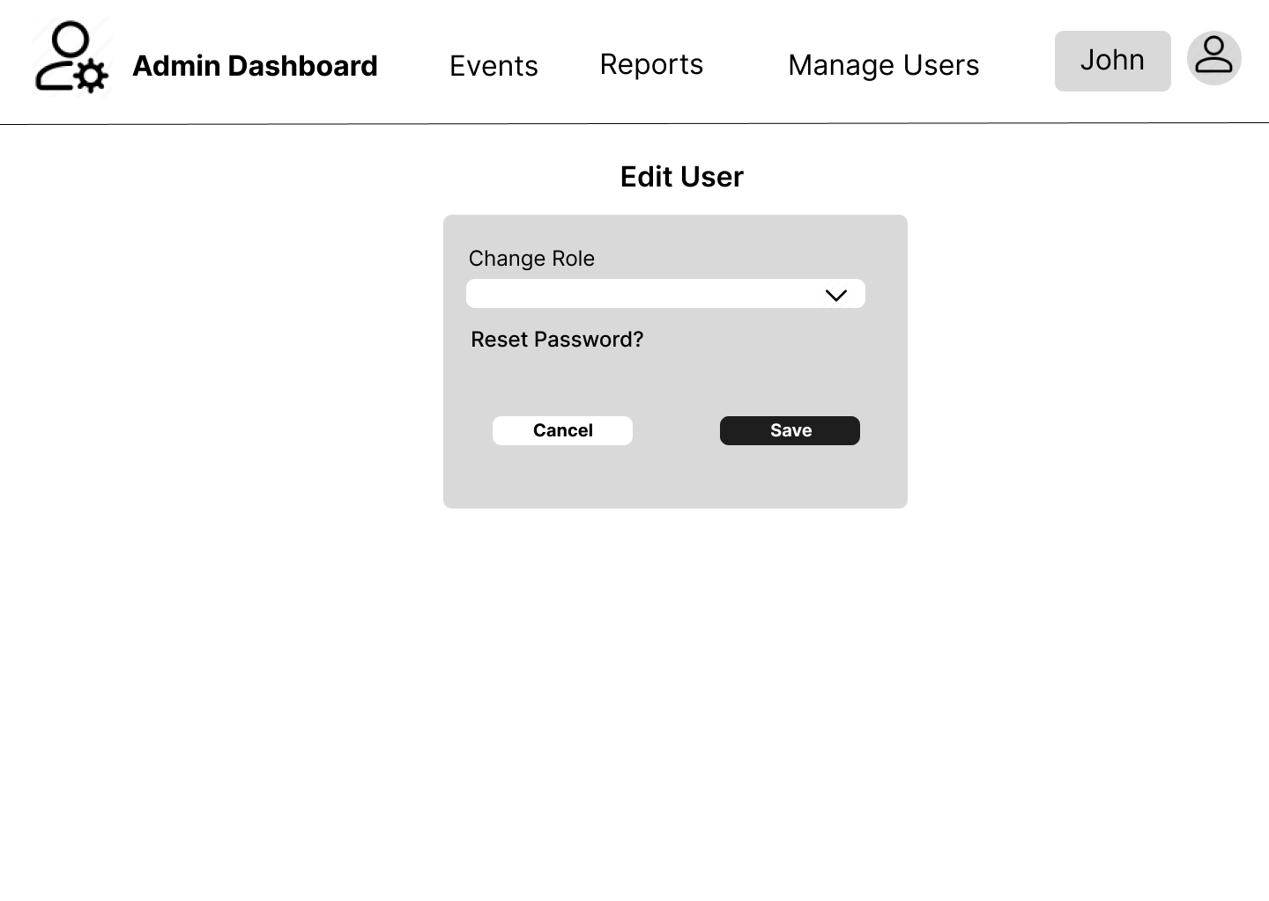

Slide 27
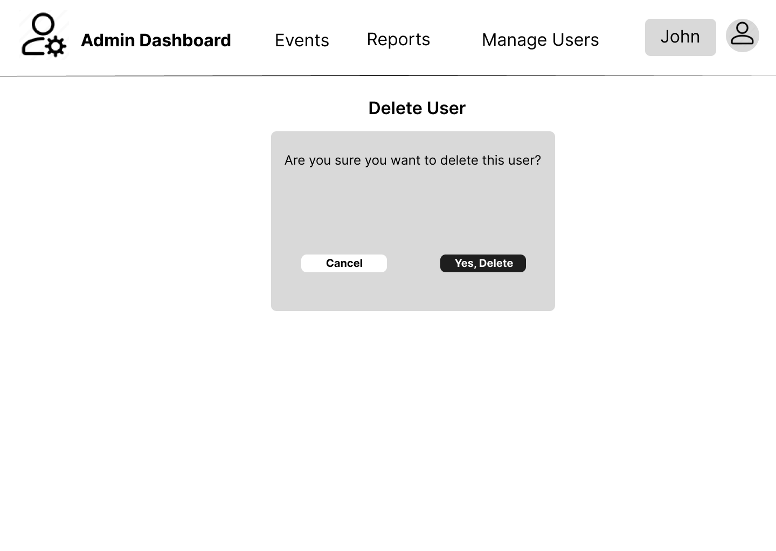

Slide 28
CURRENT PROGRESS
JJJOSE RIZAL MEMORIAL STATE UNIVERSITY

Slide 29
NEXT STEPS
JJJOSE RIZAL MEMORIAL STATE UNIVERSITY

Slide 30
END OF PRESENTATION
JOSE RIZAL MEMORIAL STATE UNIVERSITY

